Slide 1
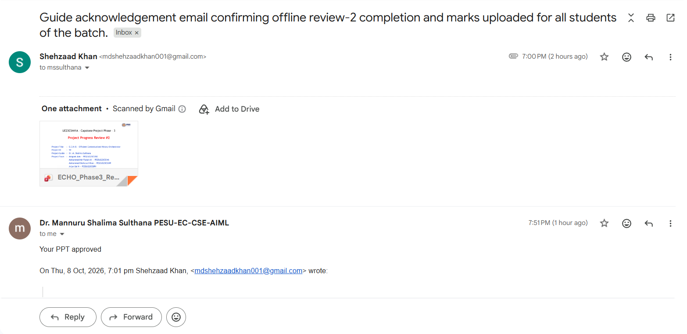

Slide 2
UE23CS441A – Capstone Project Phase – 3
Project Progress Review #2
Project Title
Project ID
Project Guide
Project Team
:
:
:
:
E.C.H.O. – Efficient Contextualized History Orchestrator
92
Dr. M. Shalima Sulthana
Mrigank Jain — PES2UG23CS352
Mohammed Mir Fazlai Ali — PES2UG23CS346
Mohammed Shehzaad Khan — PES2UG23CS349
Arjun Sai N — PES2UG23CS091

Slide 3
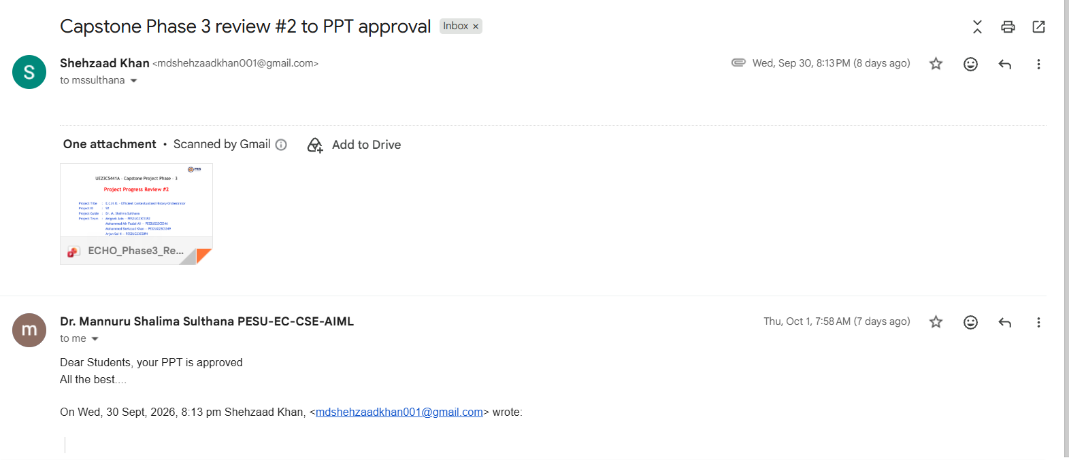
Guide Approval Mail

Slide 4
Outline
Abstract and Scope of the Project. (1 slide)
Suggestions from Review –1 of Phase-3.(1 slide)
Project Progress and Demonstration post Review-1(Phase-3)(7-8 slides)
Timeline for Pending Tasks.
Conclusion.
References.

Slide 5

Abstract and Scope
ABSTRACT:
E.C.H.O. addresses fragmented personal digital history across Gmail, Chrome, and YouTube. Instead of forcing users to remember which application contained a previous interaction, the system creates a unified, searchable memory layer.
The system captures meaningful activity, stores source-aware canonical records, enriches them for semantic search, retrieves context through hybrid deterministic retrieval, and presents results through a React dashboard and Chrome extension popup.
Phase III focus: system integration, reliable enrichment/indexing, retrieval-quality improvements, digital wellbeing analytics, and UI completion.

Slide 6
Abstract and Scope – Project Scope
The E.C.H.O. system encompasses:
01
Gmail, Chrome, and YouTube activity capture
05
Natural-language hybrid retrieval with conversational context
02
Canonical memory storage with source-specific metadata
06
Digital wellbeing analytics and user-controlled reflections
03
Intent-aware capture and revisit detection
07
React dashboard, browser extension popup, settings, export
04
Background enrichment, classification, and FAISS semantic indexing
All functionality is designed with privacy-first principles and local-first architecture.

Slide 7
Suggestions from Review - 1
Suggestions and remarks given by the panel members:
Data retention timeline: keep captured data for a fixed period (6 months or 1 year), then delete it automatically to save storage, as production systems do
Response: Planned as future work — a configurable auto-delete window (6 or 12 months).
Spam filtering: add a model that filters out spam emails before they are captured
Response: Mail that Gmail already flags as spam is never captured, since the connector reads mail without the Spam folder; a dedicated spam model is planned as future work.
Focused presentation: frame the demo to show only what is needed and leave out what isn't
Response: We have kept this review to the point — it shows only what is needed, up to the Digital Wellbeing module.

Slide 8
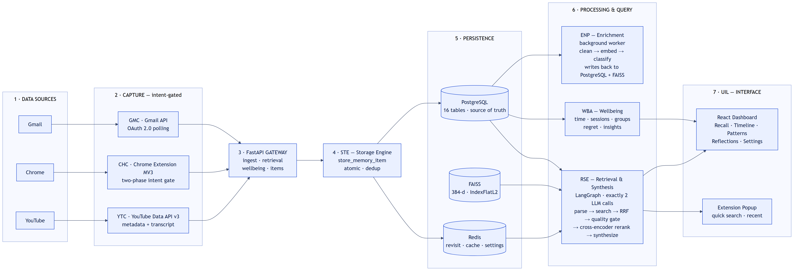
Proposed Approach / Methodology – Framework
E.C.H.O. layered architecture — capture → storage → enrichment → retrieval & wellbeing → interface

Slide 9
Proposed Approach / Methodology
Basic approach
1 Capture only engaged activity (intent gates)
2 Store atomically in PostgreSQL — the source of truth
3 Enrich in the background: clean → embed → classify
4 Answer with hybrid search and exactly 2 LLM calls
5 Reflect on time use — descriptive, never judgmental
Results obtained
All three sources captured into one PostgreSQL store
Enrichment tracks pending / processed / failed; failed items are retried on demand
Multi-turn natural-language questions answered
Wellbeing analytics implemented — live-data validation pending

Slide 10
Proposed Approach / Methodology
Is there a need for changing the approach? Yes — three changes since Phase II.
Phase II plan
Phase III approach — and why
Ranking
One weighted sum: 40% semantic + 30% engagement + 20% recency + 10% effort
Merge keyword and semantic lists by rank (RRF, k = 60), then re-score: 0.8 × cross-encoder + 0.2 × effort.
Why: the two searches score on different scales, so adding raw scores is unfair.
Recency
20% boost for recent items
Dropped on purpose, so older but still-relevant memories are not pushed down.
User groups
Suggested items auto-accepted
Suggestions start as pending; an item joins a group only after the user accepts.
Benefits
Fairer merge of keyword and semantic results
Candidates re-scored against the actual question
Still exactly 2 LLM calls; user stays in control of groups
Drawbacks
Cross-encoder adds CPU time to every query
One more local model to download and load

Slide 11
Design Approach
Approach: a layered, modular monolith — private, intent-aware memory with deterministic retrieval-augmented generation (fixed Python search steps; the LLM only writes the final answer).
Why: keeps data on the device, cuts noise, unifies search across sources, makes results explainable, and let four people build modules in parallel.
Benefits
Privacy-preserving: sensitive data stays on the device
Relevant results: meaning-based search plus engagement signals
Explainable: deterministic ranking, every step visible
Modular: independent modules, easy to maintain and extend
Low-latency design: in-memory vector index and caching
Drawbacks
Tight coupling within the monolith
Limited horizontal scalability
Deterministic pipeline limits autonomy
Desktop dependency
Alternate design approaches considered and rejected
Cloud-centric logging
Easier sync — rejected for privacy risk
Keyword-only search
Simple — rejected for poor semantic understanding
Agentic LLM retrieval
Flexible — rejected as unpredictable, not explainable
Capture everything
Maximum recall — rejected for noise and privacy

Slide 12
Design Constraints, Assumptions & Dependencies
Design constraints
Local-first; no permanent cloud copy of personal data
No capture of typed text, incognito tabs or app pages (Slack, Notion)
Exactly 2 LLM calls per query
LLM sees only the question, prior turns, short snippets and aggregated numbers
16-table schema is locked
Wellbeing language stays descriptive — no scores, no "wasted time"
No item joins a user group without the user's approval
Assumptions
A single user on desktop Chrome
Gmail, Chrome and YouTube cover most relevant activity
Engagement (time, scroll, revisits) approximates effort
Google APIs stay available and stable
Dependencies → impact
Gmail API, YouTube Data API v3: capture stops if an API or its OAuth token fails
Chrome MV3 extension APIs: Chrome and YouTube capture rely on them
PostgreSQL, Redis, FAISS: storage layers; FAISS can be rebuilt from PostgreSQL
Local models (MiniLM, cross-encoder): one-time download on first run
OpenAI gpt-4.1-mini (swappable): paid API, a small cost per query; switching provider is one config change

Slide 13
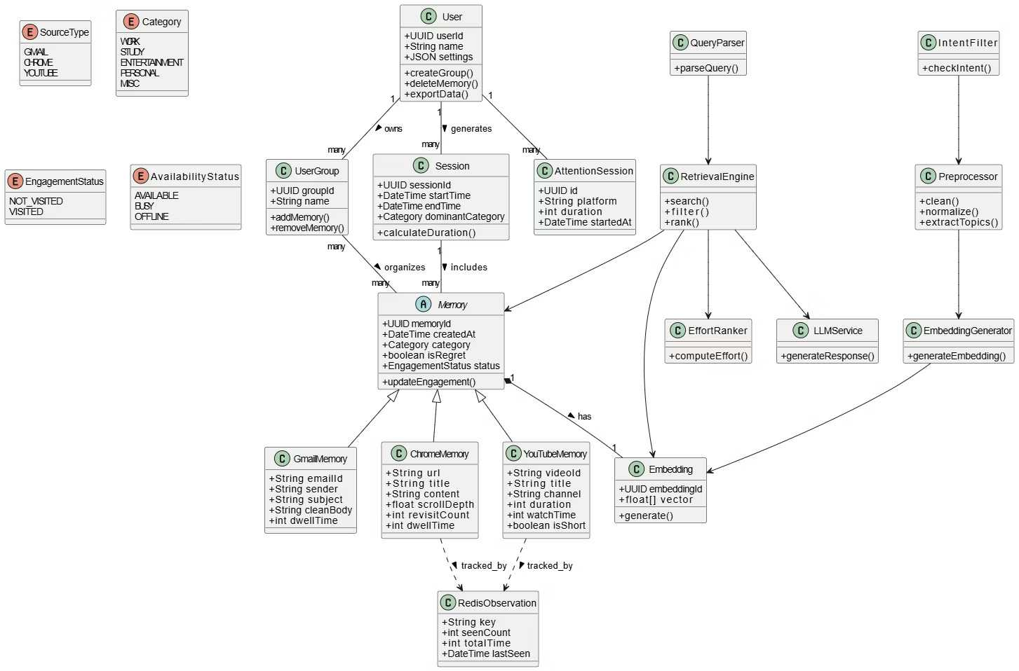
Design Description – Master Class Diagram
Master class diagram (from Phase II design)

Slide 14
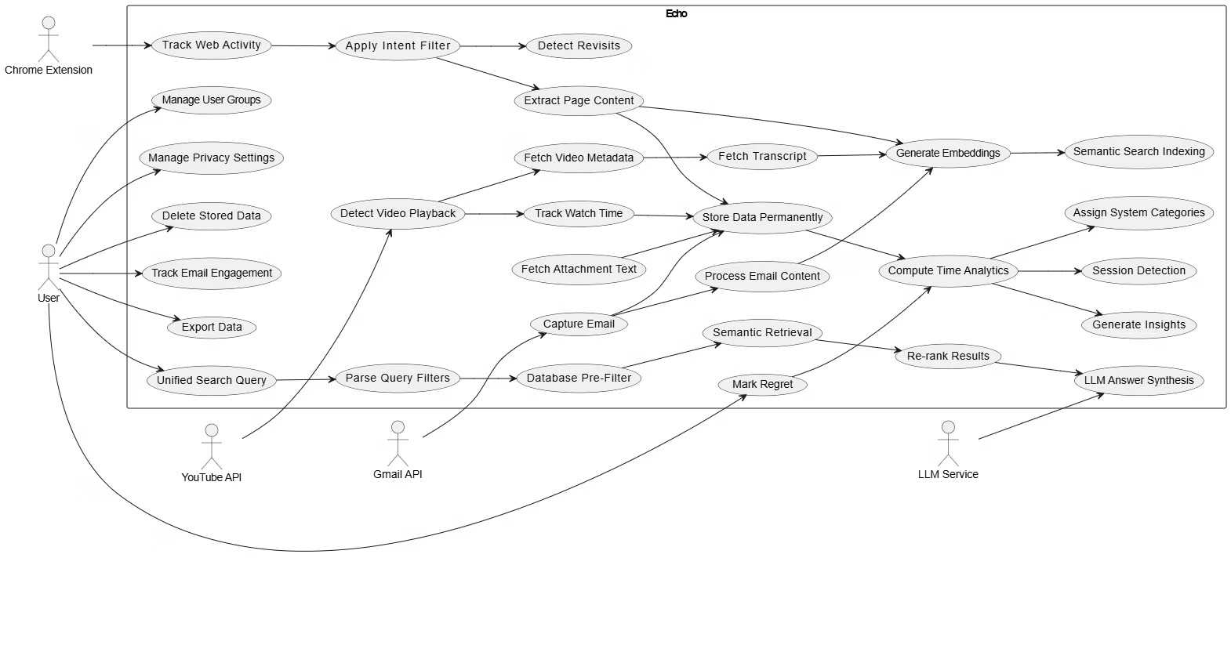
Design Description – Use Case Diagram
Use case diagram (from Phase II design)

Slide 15
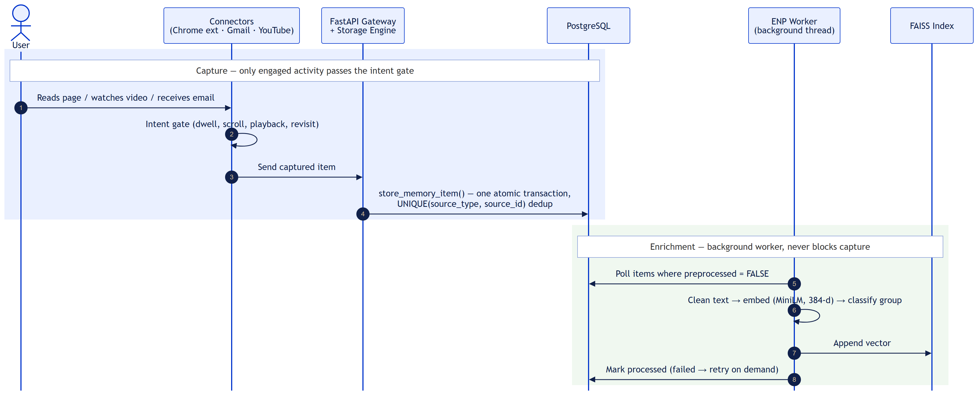
Design Description – Sequence Diagram (1/3)
Capture and enrichment

Slide 16
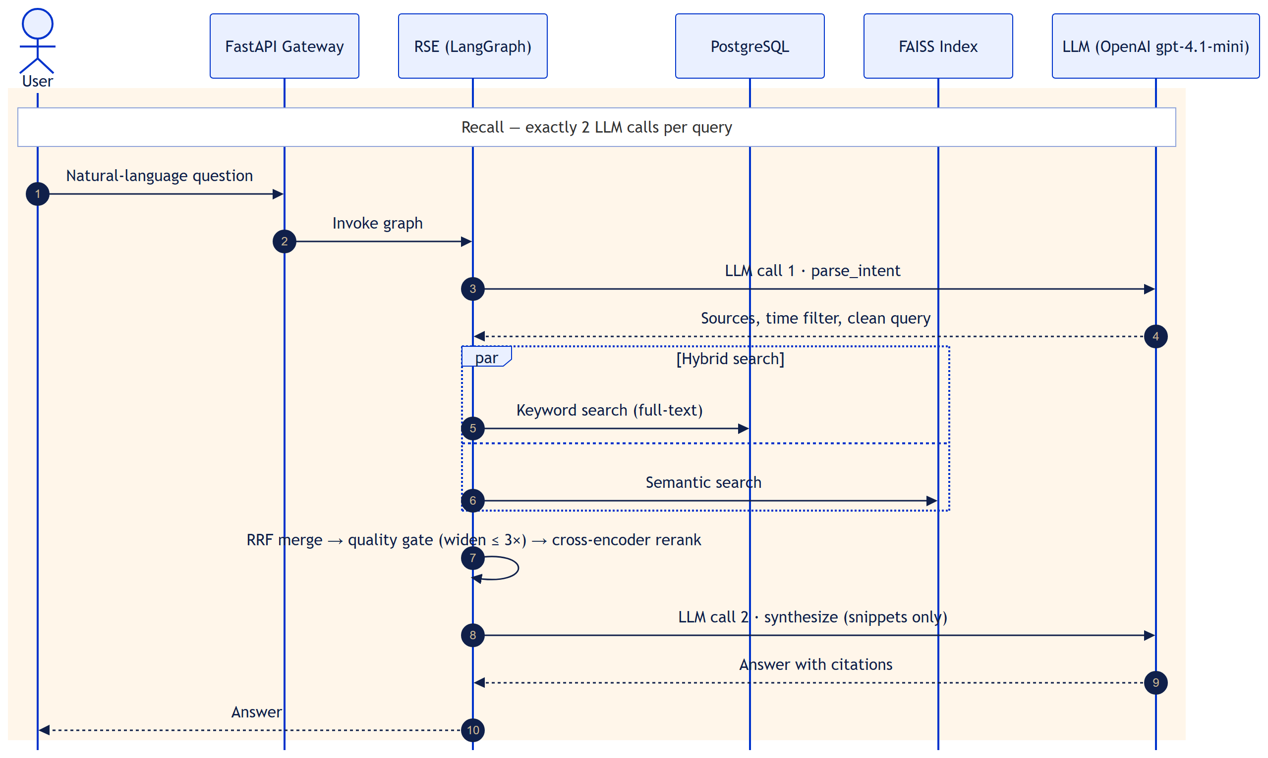
Design Description – Sequence Diagram (2/3)
Recall — exactly 2 LLM calls per query

Slide 17
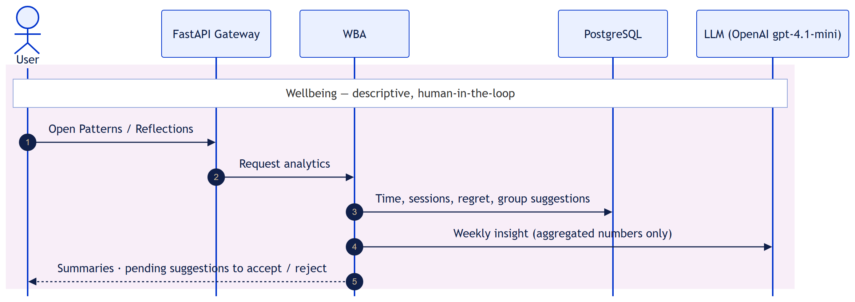
Design Description – Sequence Diagram (3/3)
Wellbeing — descriptive analytics, human-in-the-loop groups

Slide 18
Design Description – Packaging & Deployment
User's laptop — local-first runtime
Data stores
uvicorn process — FastAPI :8000 request handlers
PostgreSQL 16 · 16 tables
source of truth (Neon during development)
Chrome browser
«package» backend/
API gateway · routes
«package» extension/
Manifest V3 · intent gate
«package» ingestion/
Gmail · Chrome · YouTube connectors
«package» ste/
storage engine · Redis · settings
Redis
revisit · cache · settings
HTTP JSON
«package» frontend/
React + TypeScript · port 3000
«package» rse/
LangGraph retrieval · cross-encoder
«package» wba/
time · sessions · groups · regret · insights
External APIs
Gmail API
OAuth 2.0
Background thread
Local files
«package» enp/
ENP worker: clean · embed · classify
FAISS index
384-d vectors
YouTube Data API v3
video metadata
Local models
MiniLM · cross-encoder
OpenAI gpt-4.1-mini
2 calls per query · swappable

Slide 19
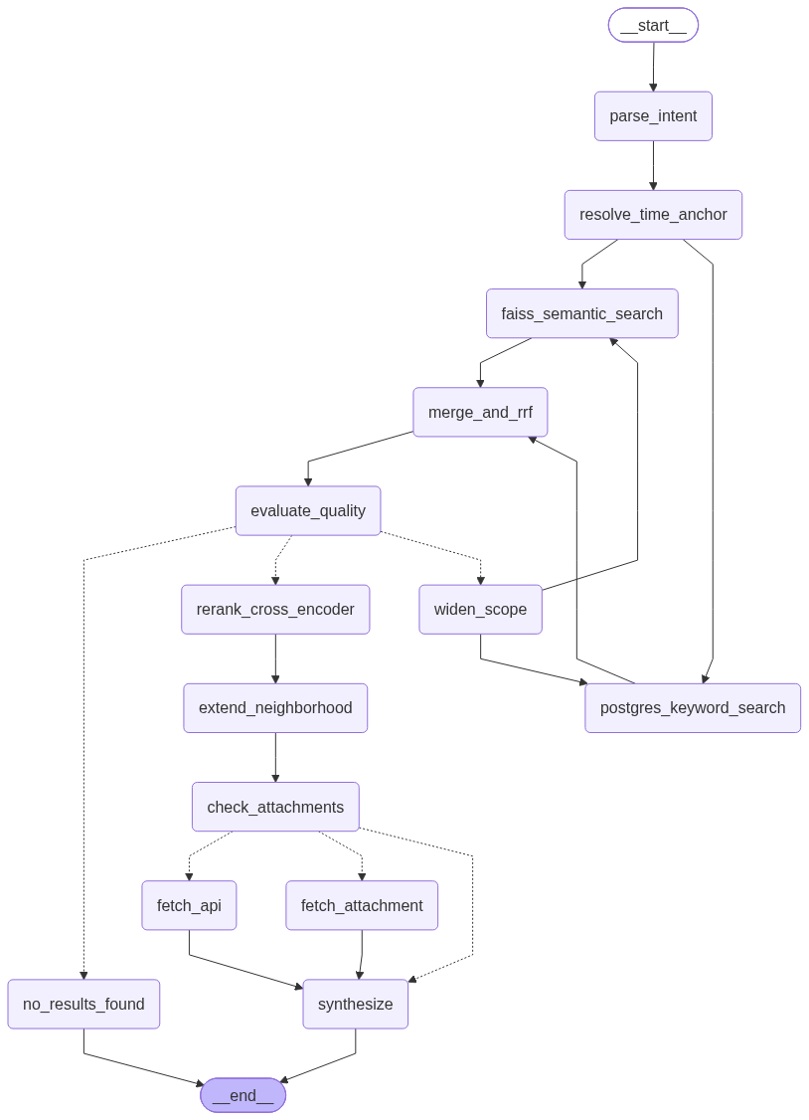
Algorithm & Pseudocode – Retrieval
function answer(question, history):
intent = LLM.parse_intent(question, history) # LLM call 1
intent = resolve_time_anchor(intent) # 'after that email' → date
attempts = 0
loop:
in parallel:
kw = postgres_fulltext_search(intent)
sem = faiss_search(embed(intent.query))
pool = RRF(kw, sem) # score = Σ 1 / (60 + rank)
quality = evaluate(pool) # 5 checks → strong/weak/empty
if quality == strong: break
if attempts == 3: return no_results_found()
intent = widen_scope(intent); attempts += 1
top = rerank(pool) # 0.8·cross-encoder + 0.2·effort
top = add_neighbours(top) # same thread / session
ctx = fetch_attachment_or_live_gmail(top) # if asked
return LLM.synthesize(question, top, ctx) # LLM call 2
Live LangGraph: 14 nodes

Slide 20
Algorithm & Pseudocode – Wellbeing
# User-group suggestions — hybrid rules + KNN
for each recent item, for each active group:
if group has < 6 confirmed items: skip # not enough examples yet
rule = rules matched / total rules
knn = mean cosine similarity of the 3 most similar confirmed members
score = 0.5·rule + 0.5·knn
if score > 0.70 or rule > 0:
add suggestion with decision = 'pending'
# weekly review: accept → item joins the group
# reject → item is never added
Human-in-the-loop by design: an item enters a user group only through an explicit user action — adding it by hand, or accepting a suggestion in the review queue.

Slide 21
Project Progress So Far
80%
Done — shown at Review 1
Capture (Gmail, Chrome, YouTube) · Storage engine · Enrichment · 14-node hybrid retrieval engine
New since Review 1 — Wellbeing module (WBA)
Regret marking, patterns by hour and category, gentle reminders (max 2 a day)
User groups: rules + KNN suggestions, weekly review queue, suggested rules
Wellbeing API routes for the dashboard
of E.C.H.O. complete
Done — 80%
UI — 10%
Cleanup & hardening — 10%
Wellbeing module implemented; validation on live data is pending (scheduled in October).
Remaining — 20%
UI (10%): finish the dashboard screens and the extension popup
Cleanup (10%): fix breaking paths, add logging, clean code, remove dead code

Slide 22
Project Demonstration
Demo plan — each part is shown on its own, in the order data flows through the system. There is no static dataset: data is created live by the user's own activity.
NEW since Review 1
1
2
3
4
Dataset creation
Enrichment
Recall
Wellbeing (WBA)
Open a web page, watch a YouTube video, receive an email.
Each engaged item appears as a new row in PostgreSQL.
The background worker picks up new items.
Show an item move from pending to processed, with its category.
Ask a question, then a follow-up that refers to it.
Show the answer — 2 LLM calls.
Today's summary and sessions; mark an item as regretted.
Accept a group suggestion; view a weekly insight.

Slide 23
Timeline – Update on Pending Tasks
Target: 100% complete in the last week of October
October · Week 1
October · Week 2
October · Week 3
October · Week 4 · final
UI completion
10%
Implement wellbeing screens and popup; connect to the API
Citation cards, source-breakdown chart, group-review polish
Refactor & hardening
10%
Fix breaking paths, add logging, remove dead code
Validation & finish
End-to-end run of all 3 sources; WBA on live data
Final testing, retrieval quality check, privacy check, documentation
Carried forward from Review 1: wellbeing validation, dashboard refinements, end-to-end validation, retrieval quality measurement, privacy audit and documentation — all covered above.

Slide 24
Conclusion
1
80% complete
Capture, storage, enrichment, hybrid retrieval and — new since Review 1 — the Wellbeing module are implemented.
2
Two deliberate design changes
Rank-based fusion with cross-encoder re-ranking, and user approval before any item joins a group.
3
Remaining 20%
UI completion and code hardening, finishing in the last week of October.
E.C.H.O. stays local-first and private: the LLM only ever sees the question, short snippets and aggregated numbers.

Slide 25
References
REFERENCES (IEEE Format):
[1] N. Reimers and I. Gurevych, "Sentence-BERT: Sentence embeddings using Siamese BERT-networks," in Proceedings of the 2019 Conference on Empirical Methods in Natural Language Processing, 2019.
[2] J. Johnson, M. Douze, and H. Jégou, "Billion-scale similarity search with GPUs," IEEE Transactions on Big Data, vol. 7, no. 3, pp. 535–547, 2021.
[3] LangChain and LangGraph Documentation, "Building language model applications with composable components," https://python.langchain.com, 2024.
[4] M. Kleppmann, A. Wiggins, P. van Hardenberg, and M. McGranaghan, "Local-first software: You own your data, in spite of the cloud," in Proceedings of the 2019 ACM SIGPLAN International Symposium on New Ideas, New Paradigms, and Reflections on Programming and Software, 2019.

Slide 26
Thank You

